Slide 1

CUI WAH CAMPUS
COMSATS University Islamabad, Wah Campus
Department of Computer Science
LECTURE # 11
SUBJECT NAME: Automata Theory
INSTRUCTOR: Waheed Ahmad Khan

Slide 2

Topic Covered
Finite Automata/ FA , Deterministic Finite Automata / DFA

Slide 3
Finite Automata/ FA , Deterministic Finite Automata / DFA
DEFINITION:
A finite automaton (FA) is the following 3 things:
1. a finite set of states, one of which is designated as the
start state, and some (maybe none) of which are
designated the final states (or accepting states)
2. an alphabet S of input letters
3. a finite set of transitions that indicate, for each state
and letter of the input alphabet, the state to go to next
Letter
state -------------→ state

Slide 4
Deterministic Finite Automaton (DFA)
The language defined or accepted by a finite automaton is the set of words that end in a final state.
If w is in the language defined by a finite automaton, then we also say that the finite automaton accepts w.

Slide 5
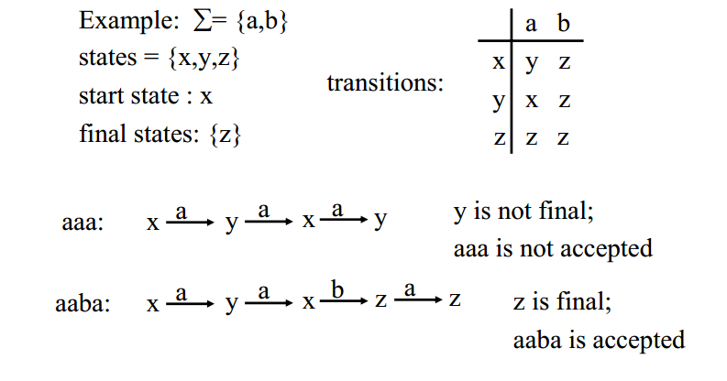
Deterministic Finite Automaton (DFA)

Slide 6
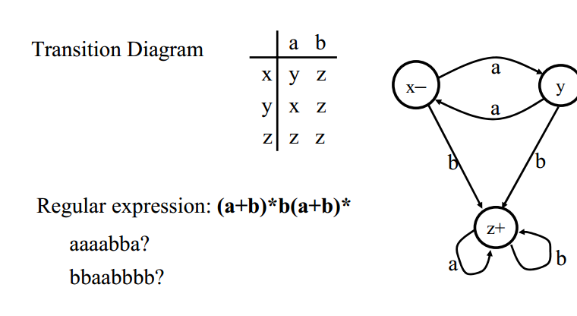
Deterministic Finite Automaton (DFA)

Slide 7
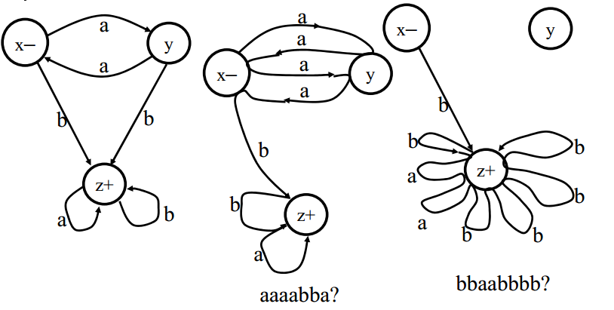
Deterministic Finite Automaton (DFA)

Slide 8
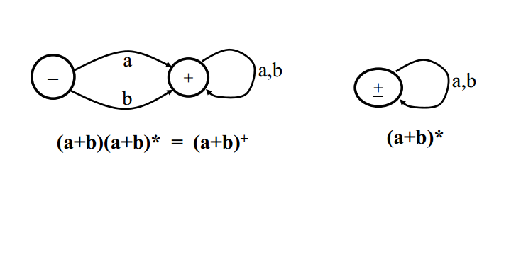
Deterministic Finite Automaton (DFA)

Slide 9
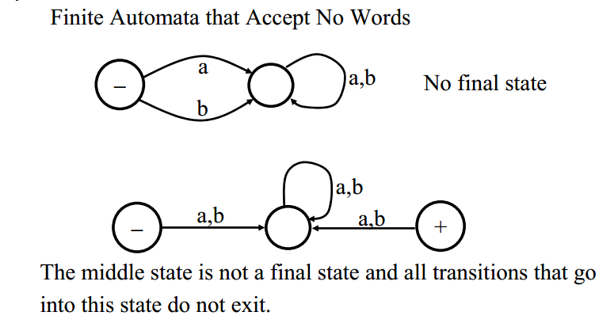
Deterministic Finite Automaton (DFA)

Slide 10
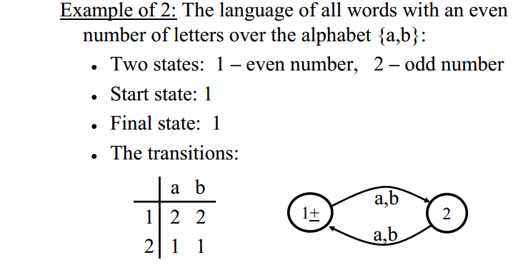
Deterministic Finite Automaton (DFA)

Slide 11
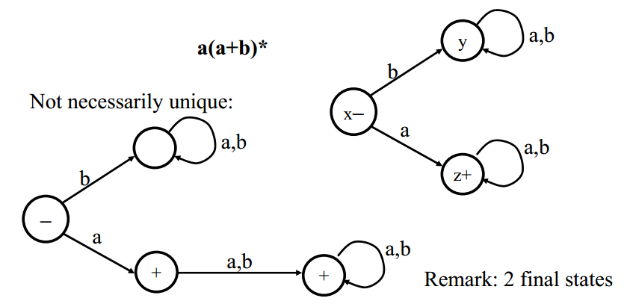
Deterministic Finite Automaton (DFA)

Slide 12
Deterministic Finite Automaton (DFA)
From Languages to Finite Automata
There is not necessarily a unique FA that accepts a given language.
Is there always at least one FA:
that accepts each possible language?
that defines a language associated with a given regular expression?

Slide 13
Deterministic Finite Automaton (DFA)
Example: Build an FA that accepts all words containing a triple letter (either aaa or bbb).
1. Build an FA that accepts aaa
2. Add a path that accepts bbb.
3. Add paths for words that contain a’s and b’s before or afterthe aaa or bbb.

Slide 14
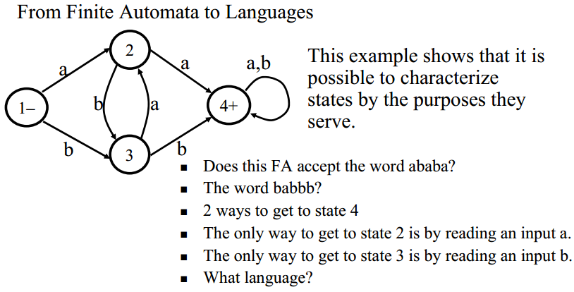
Deterministic Finite Automaton (DFA)

Slide 15
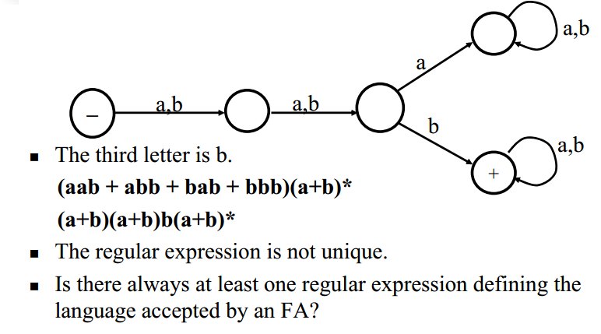
Deterministic Finite Automaton (DFA)

Slide 16
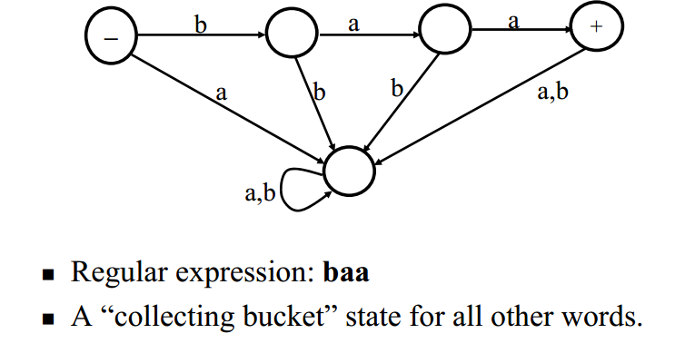
Deterministic Finite Automaton (DFA)

Slide 17
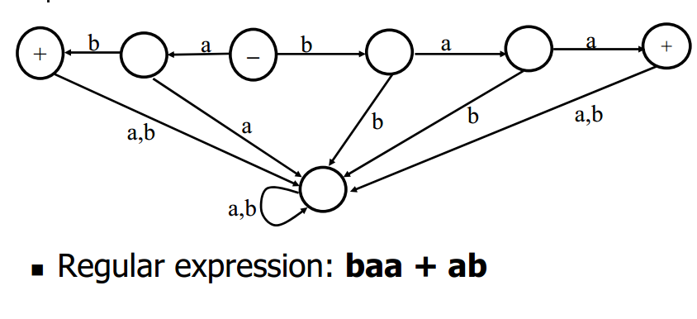
Deterministic Finite Automaton (DFA)

Slide 18
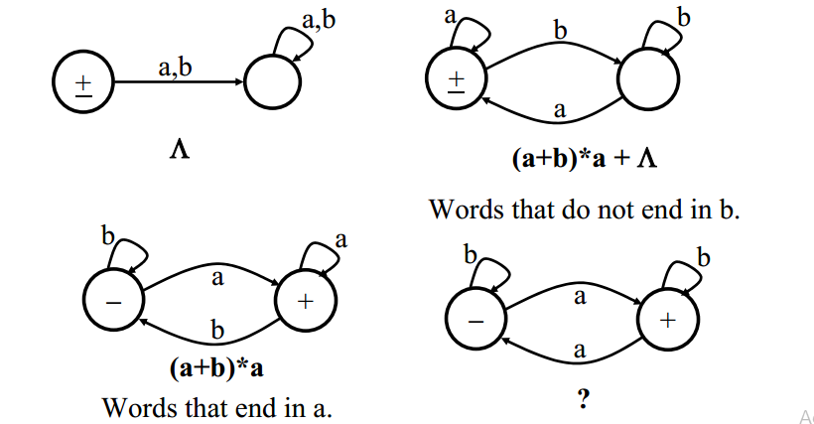
Deterministic Finite Automaton (DFA)

Slide 19
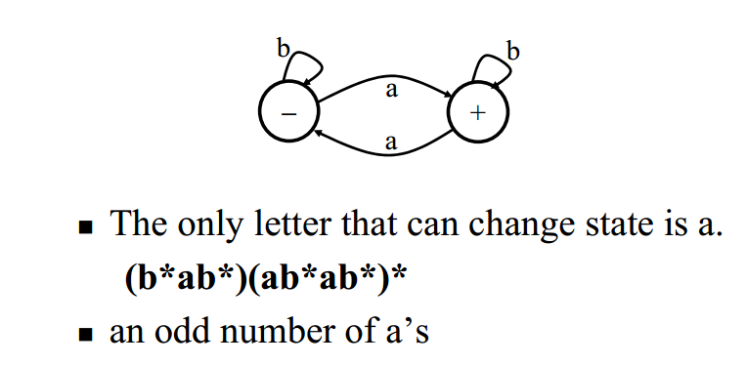
Deterministic Finite Automaton (DFA)

Slide 20
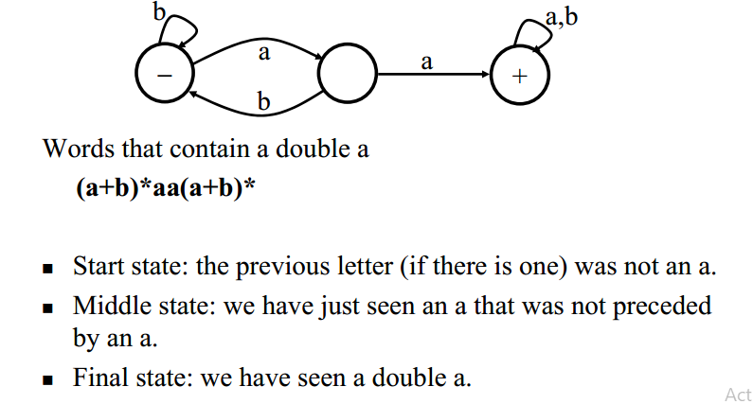
Deterministic Finite Automaton (DFA)

Slide 21
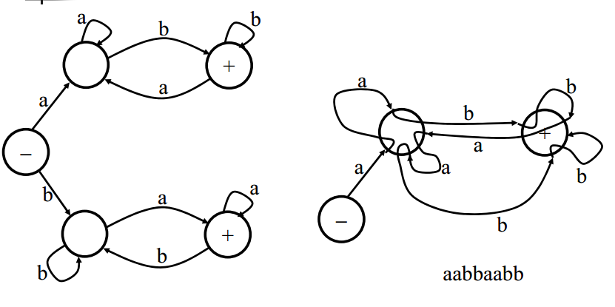
Deterministic Finite Automaton (DFA)

Slide 22
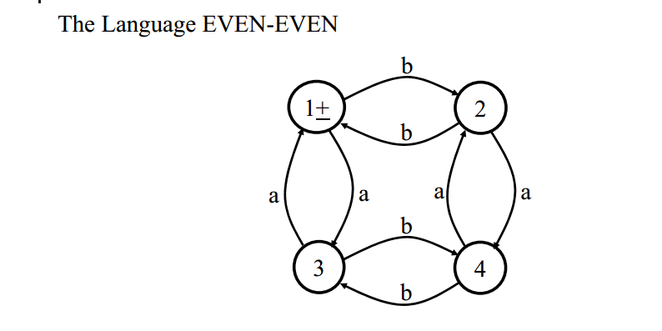
Deterministic Finite Automaton (DFA)

Slide 23
ASSIGNMENT 3:
Build an FA that accepts only the words baa, ab, and abb and no other strings longer or shorter.
Build a new FA that accepts only the word NULL.
Build an FA with three states that accept all words.
Build an FA that accepts only those words that have an even number of letters total.
Build an FA that accepts only those words that do not end with ba.
Build an FA that accepts only those words that begin or end with a double letter.
Build an FA that accepts only those words that have more than four letters.
Build an FA that accepts only those words that have fewer than four letters.

Slide 24
Thank You…

